Slide 1


Chunked, Compressed, & Cloud-native N-dimensional arrays
FOSS United x ILUG-D Meetup
18th May, 2024 @ IFF

Slide 2


Sanket Verma
@MSanKeys963
Community and OSS @ Zarr

Slide 3

Slides
https://bit.ly/zarr_foss_ilugd

Slide 4

GitHub Repository
https://bit.ly/foss_ilugd_more

Slide 5
What I’ll be talking about?
→ What is Zarr?
→ How is Zarr different?
→ What is the Zarr Community and ZEPs?
→ Demo

Slide 6
How Zarr works?

Slide 7
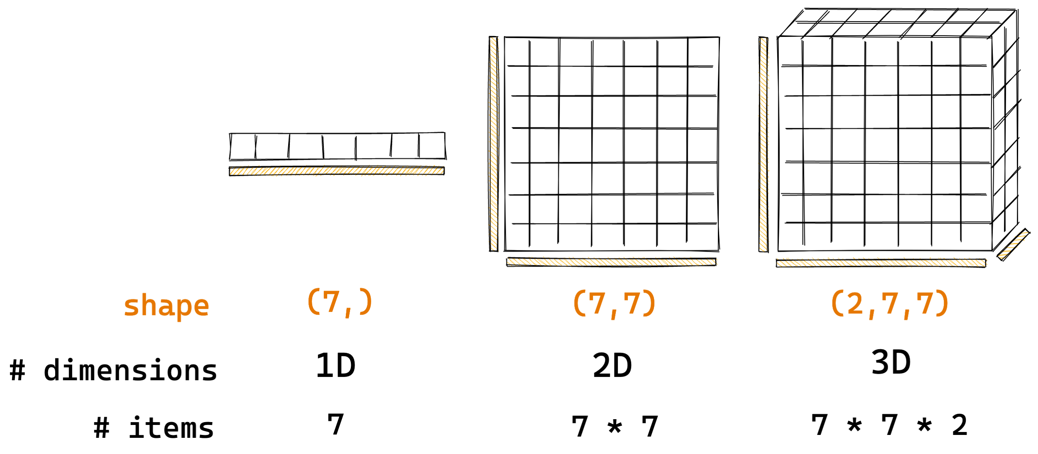
How Zarr works?
Arrays are container of items of the same data-type & size (in bits). The number of dimensions and items in container are described by the shape.
Credit: @trevmanz

Slide 8

How Zarr works?
Credit: @trevmanz

Slide 9
How Zarr works?
What if the data is too big to fit in memory?
Credit: @trevmanz

Slide 10
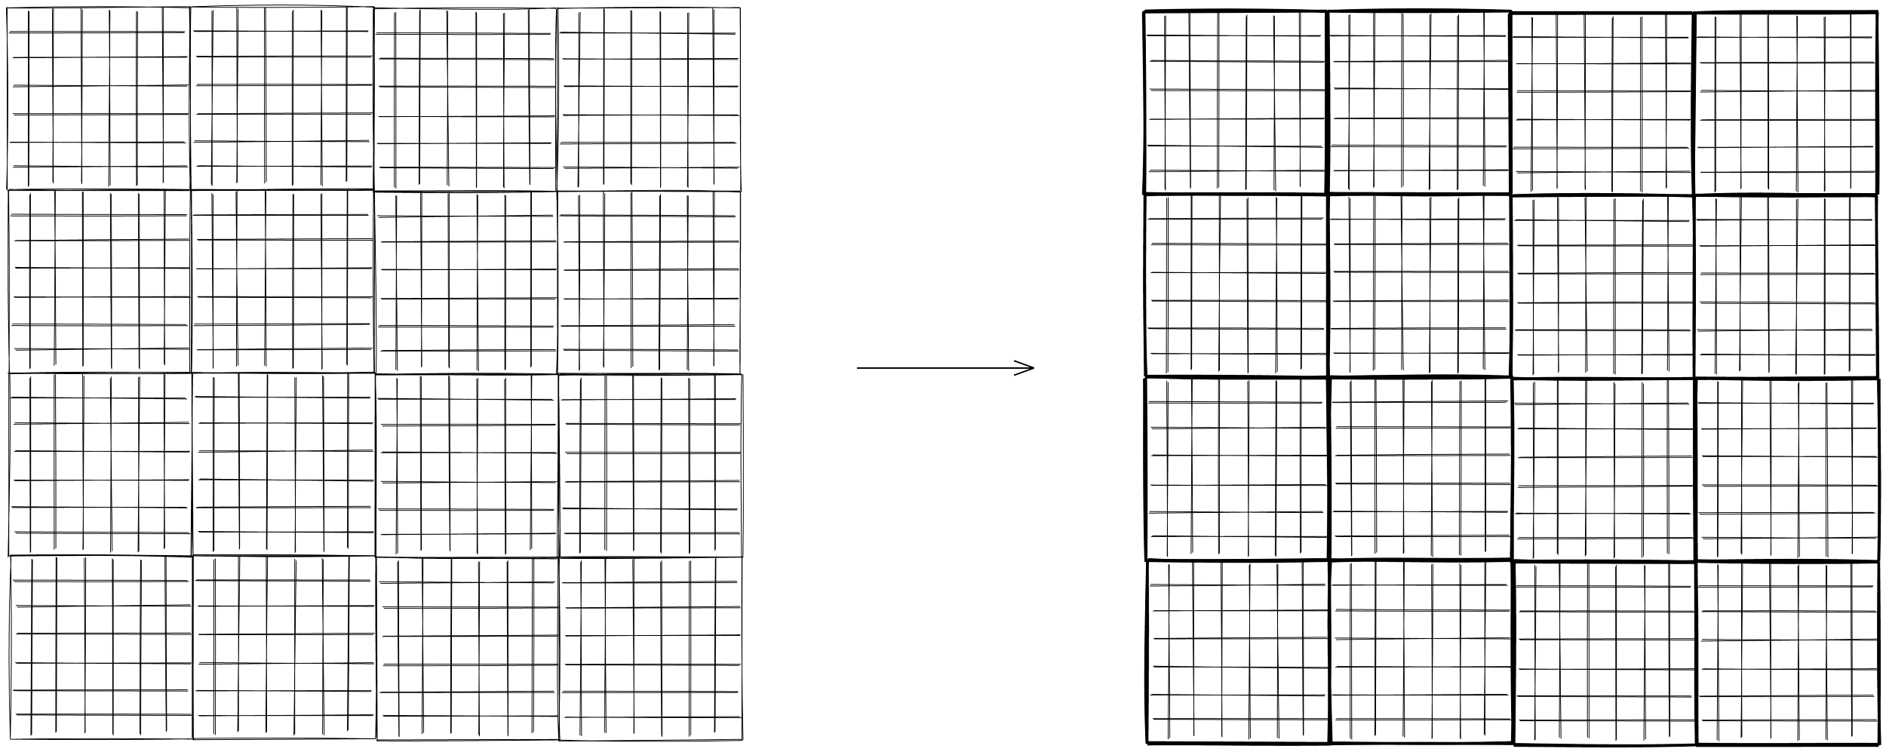
How Zarr works?
Divide array into chunks (Chunking)
Credit: @trevmanz

Slide 11
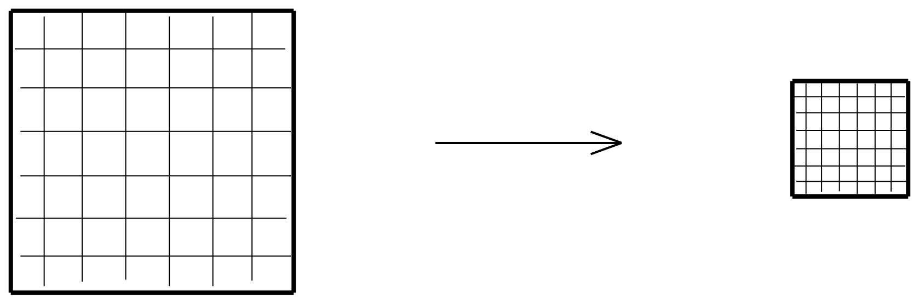
How Zarr works?
Compress each chunk
Over 20 supported compressors (BLOSC, Zstd, Zlib etc)
Credit: @trevmanz

Slide 12
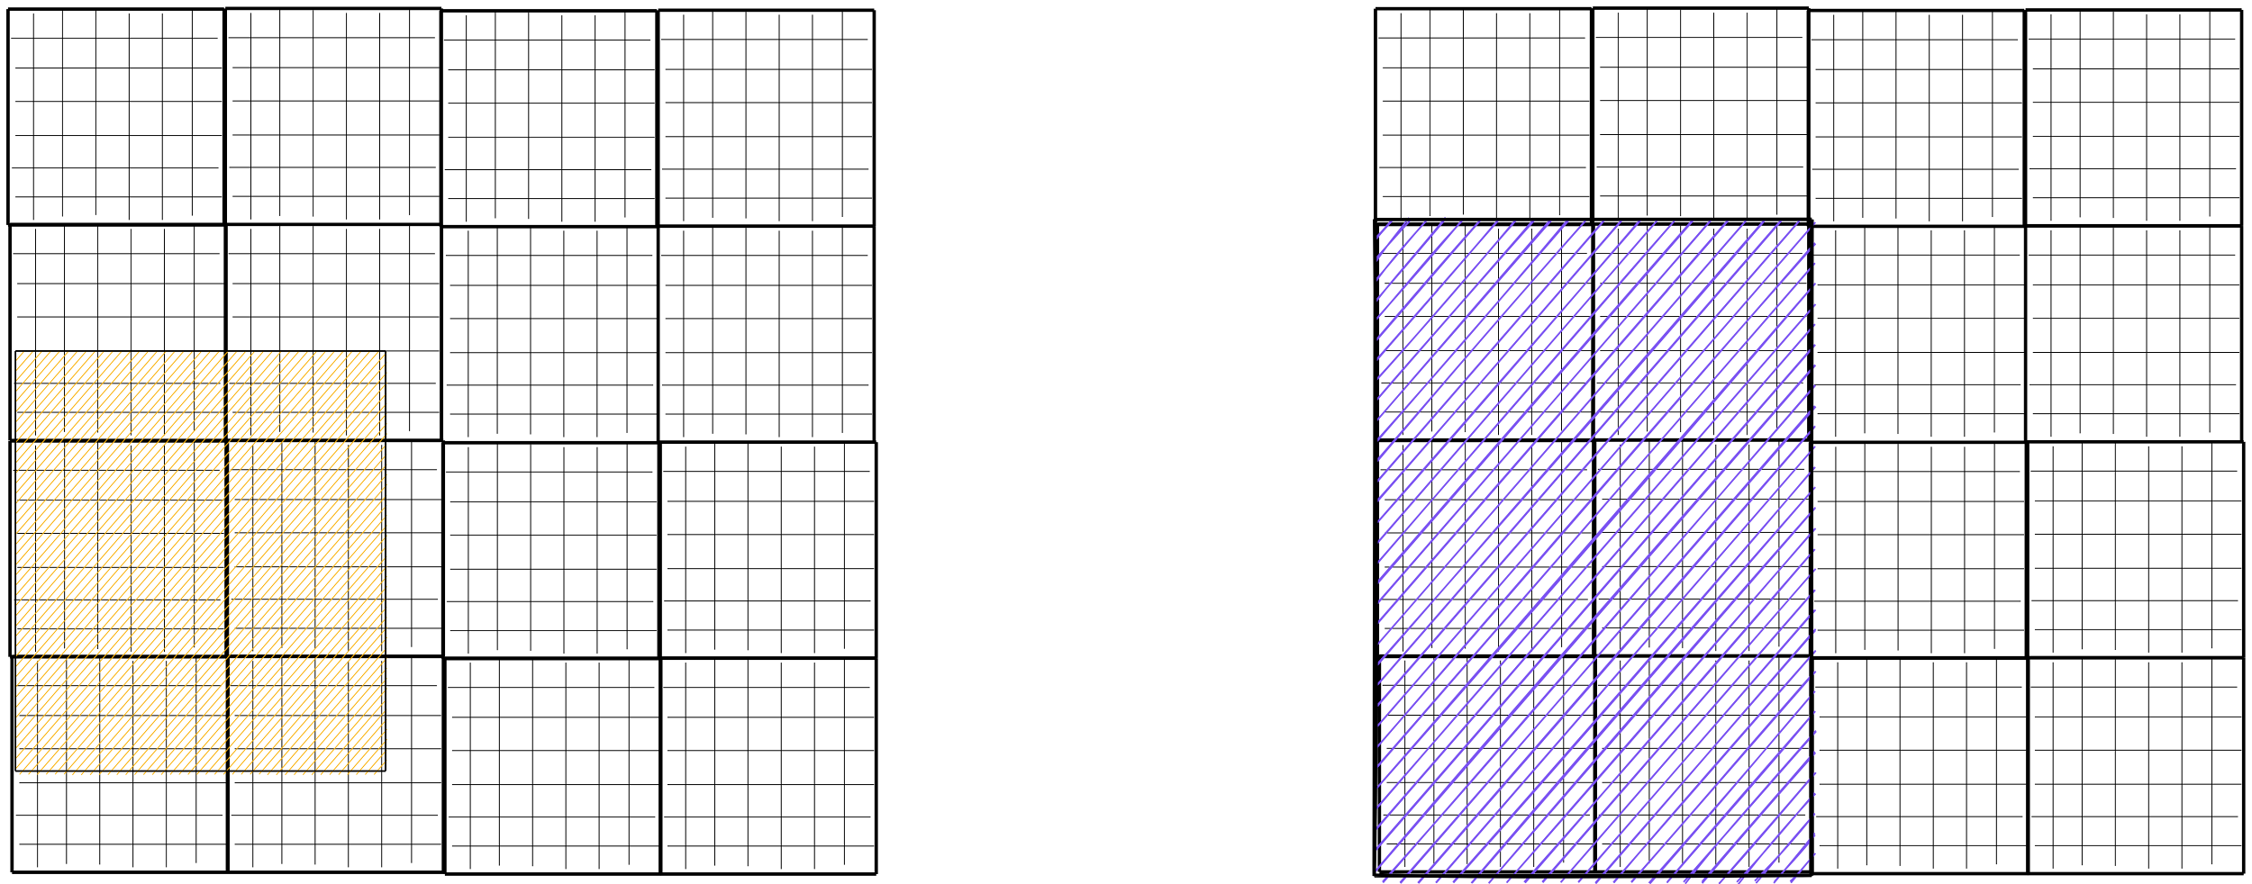
How Zarr works?
Retrieve chunks only when needed
Credit: @trevmanz

Slide 13
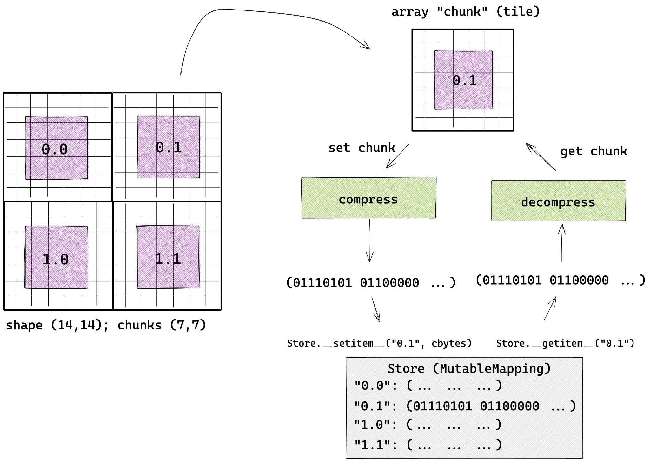
How Zarr works?
Credit: @trevmanz

Slide 14
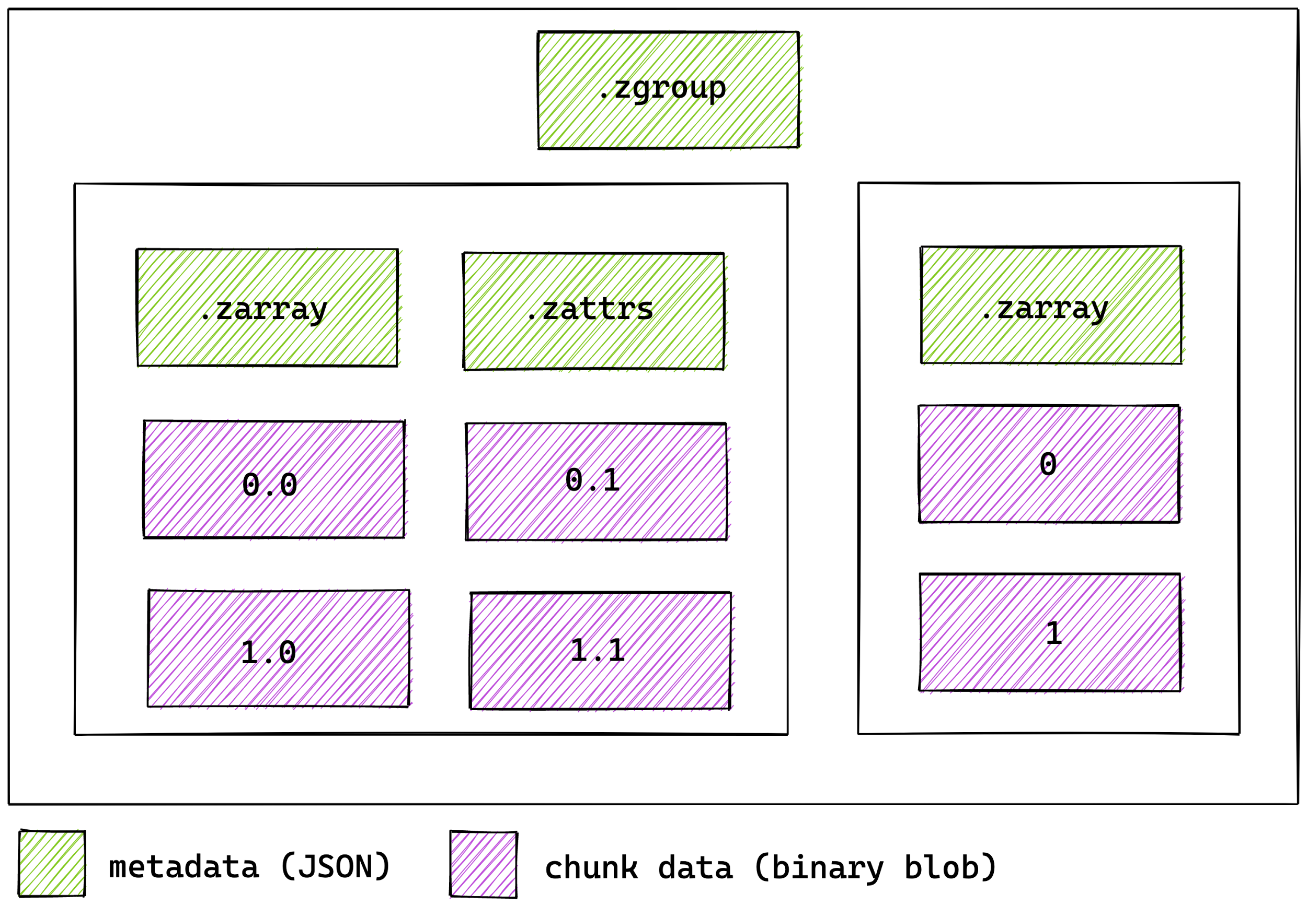
How Zarr works?
Multiple arrays can be organised in hierarchies of groups
Credit: @trevmanz

Slide 15



Benefits of Zarr
Distributed & Cloud Storage Chunked Storage
Built-In Compression
Notes:
Simple. → Spec.

Slide 16
How Zarr is different?

Slide 17
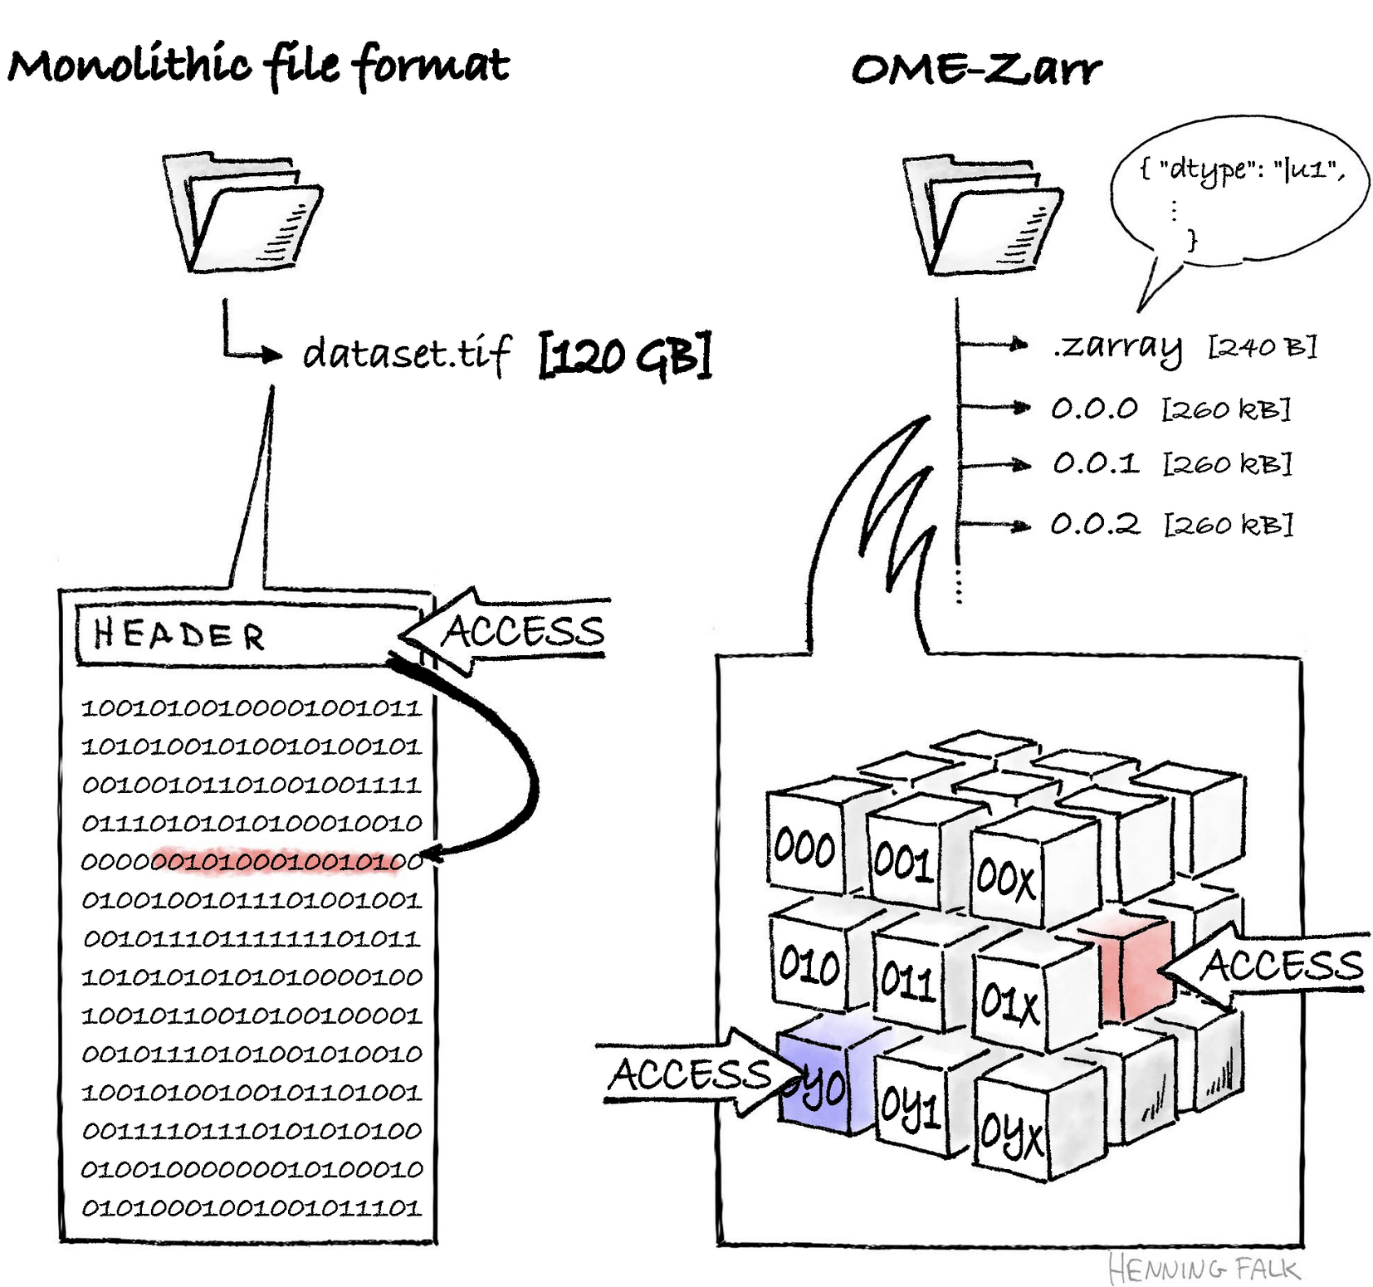

Slide 18
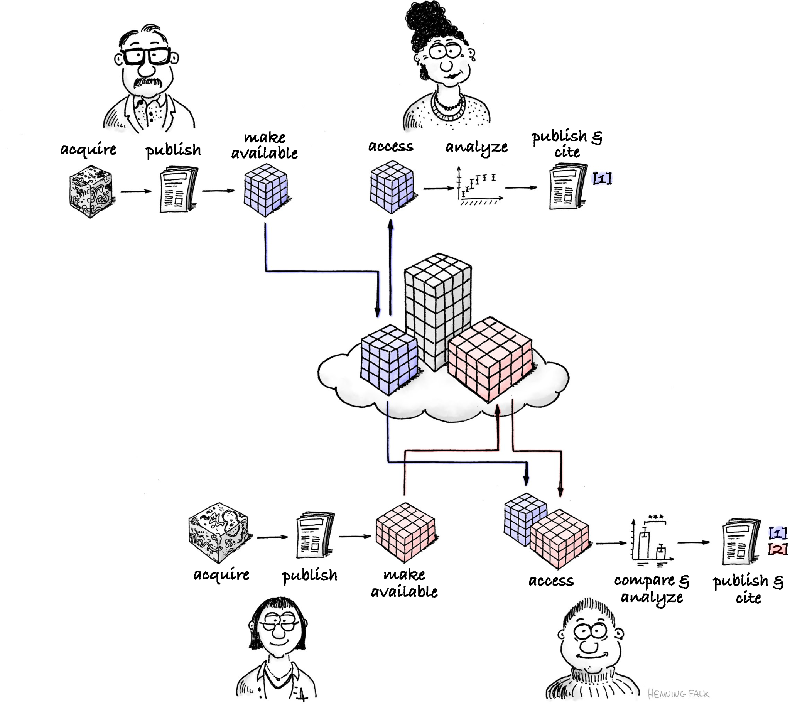

Slide 19
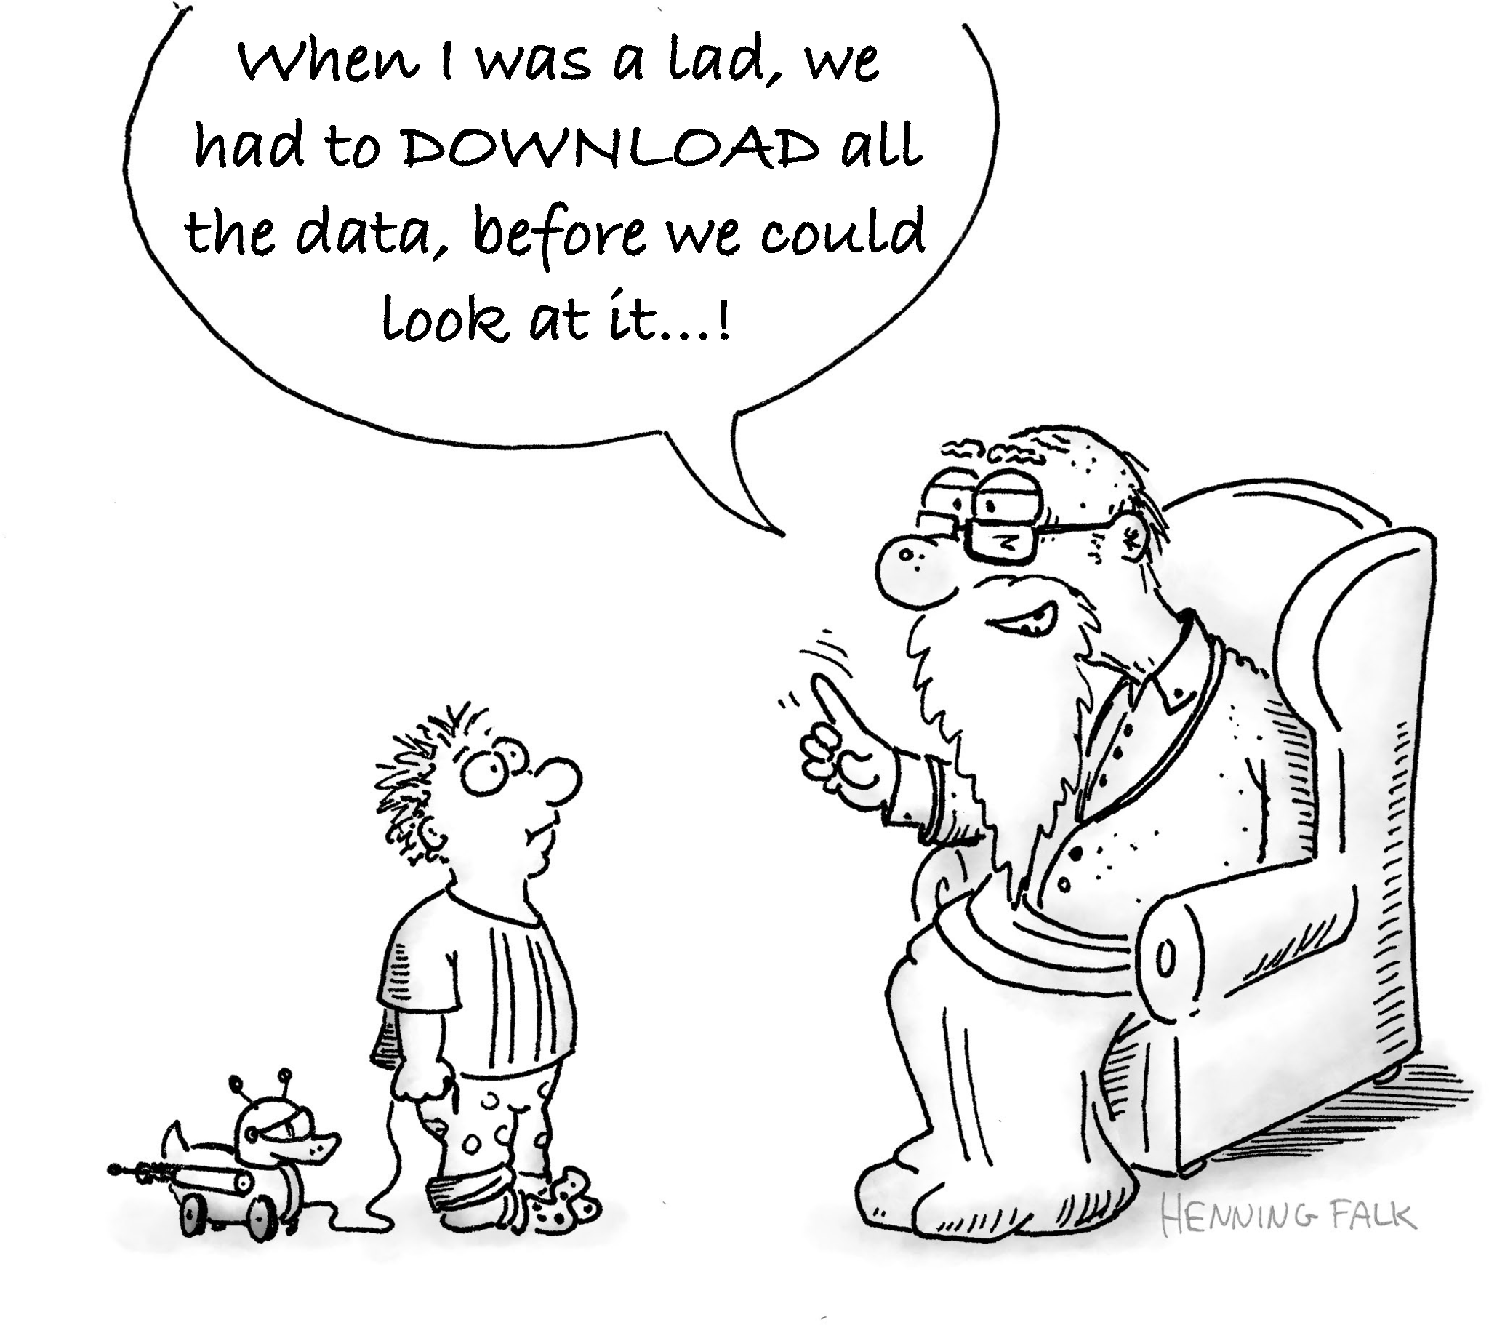

Slide 20

More illustrations
Check here 👉🏻

Slide 21
Zarr Specification

Slide 22

Zarr Specification
V1 → V2 → V3
https://zarr-specs.readthedocs.io/

Slide 23
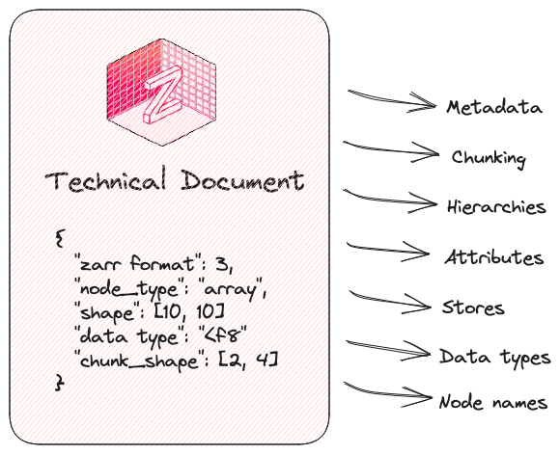
Zarr Specification

Slide 24







↔

Slide 25
Why did we work on V3 Specification?

Slide 26
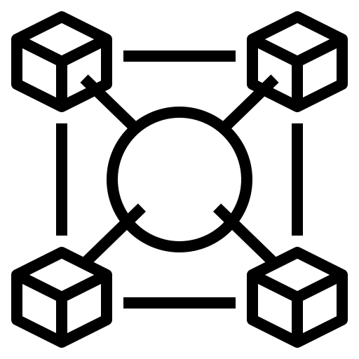


The Motivation
Interoperability High-latency storage
Extensibility
Notes:
Simple. → Spec.

Slide 27
Major design updates

Slide 28
Restructured the JSON metadata

Slide 29
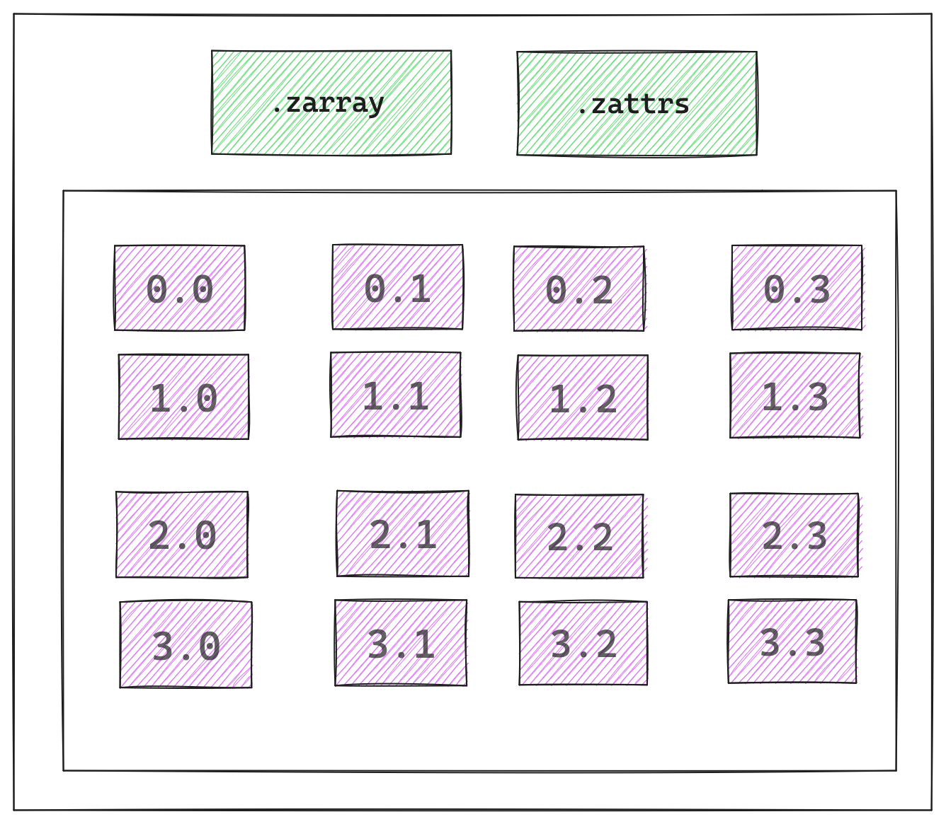
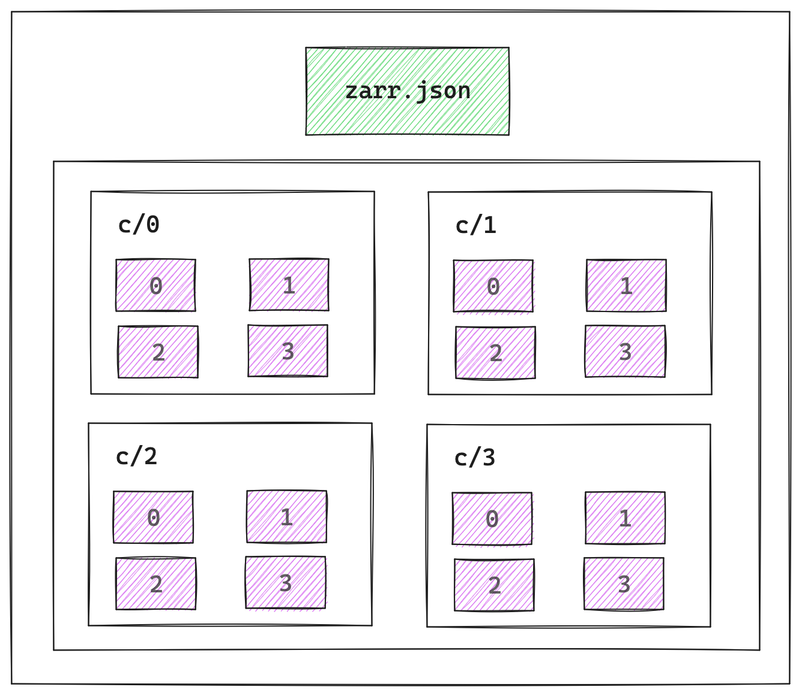
Zarr Arrays → V2 vs. V3
V2
V3

Slide 30
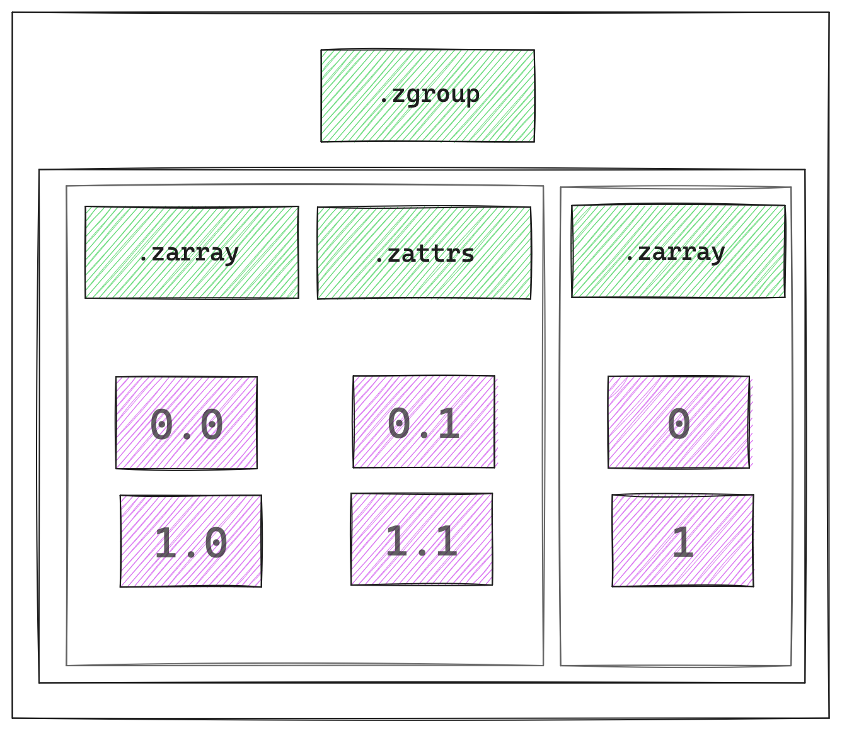
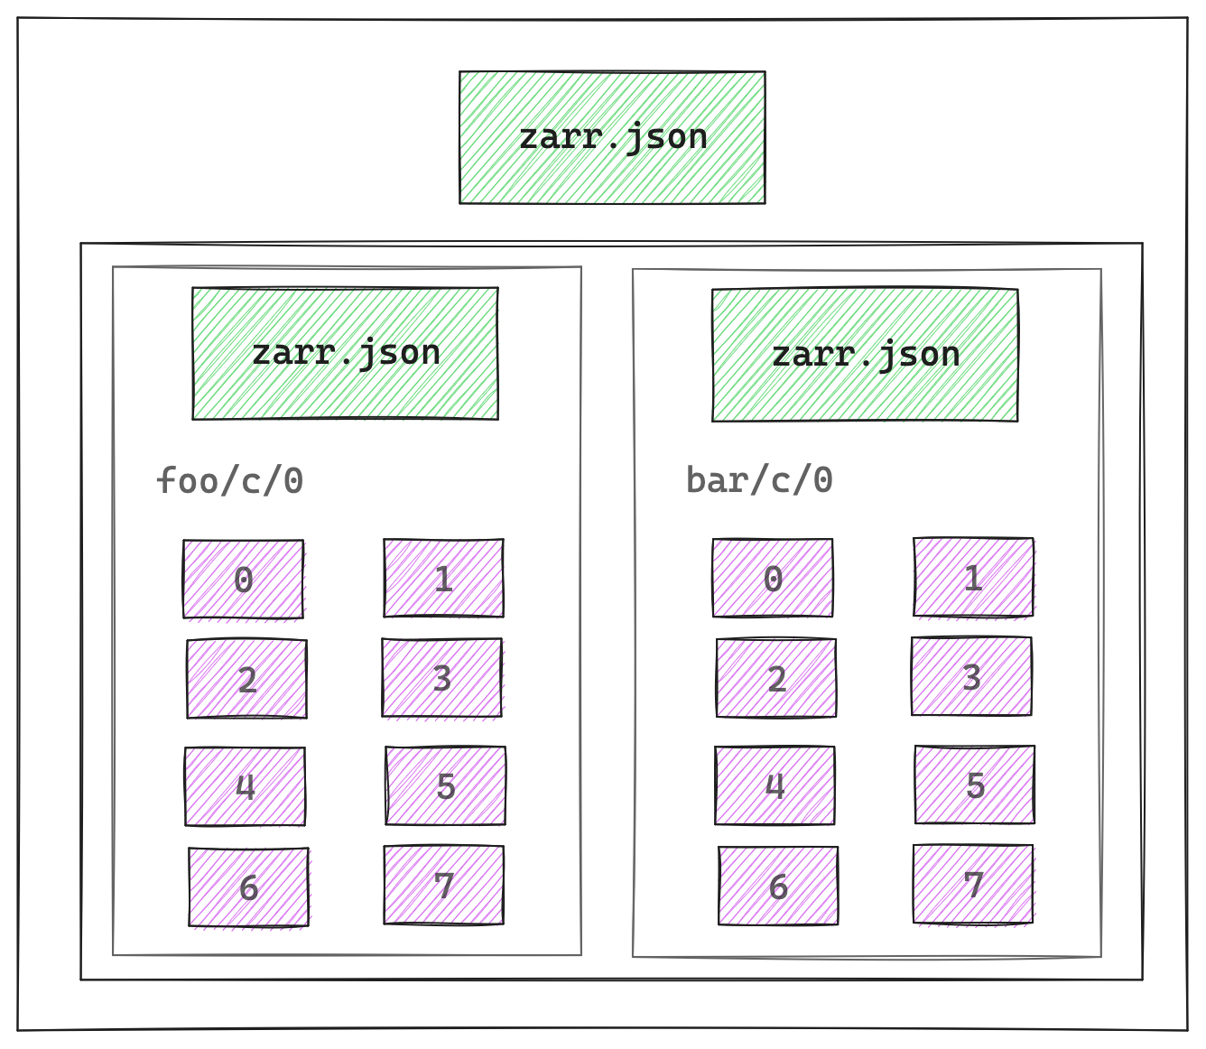
Zarr Groups → V2 vs. V3
V2
V3

Slide 31
Zarr Community

Slide 32


Slide 33
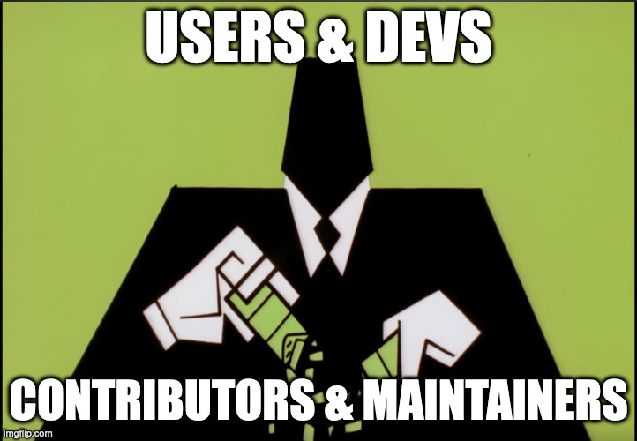

Slide 34
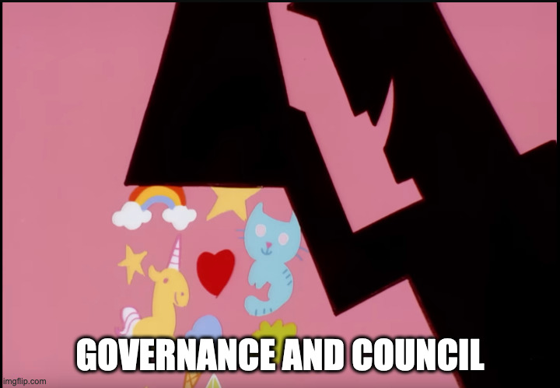

Slide 35


Slide 36
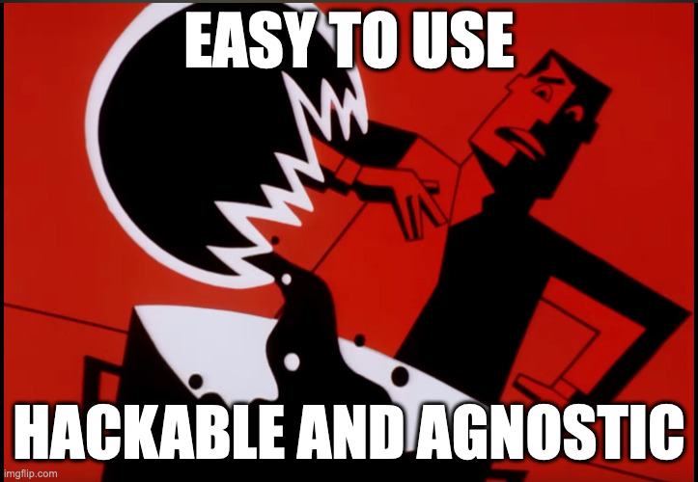

Slide 37


Slide 38


Slide 39


Slide 40
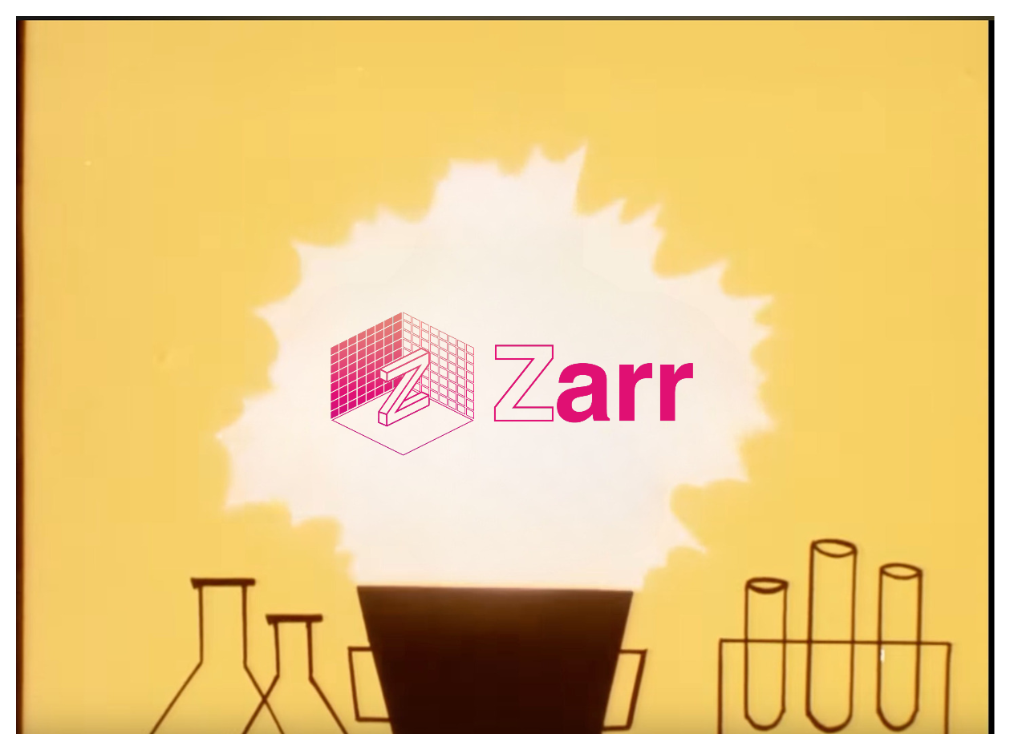

Slide 41
We have a large and diverse active community!
But…👀

Slide 42
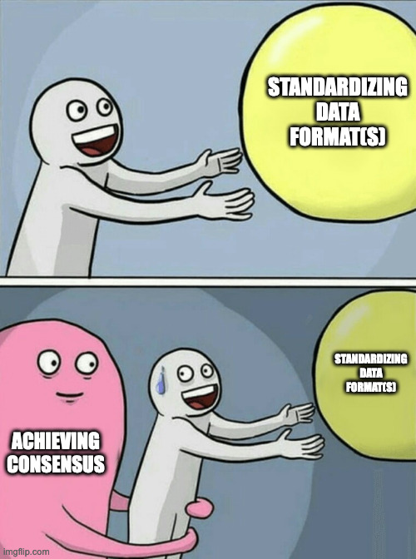


Slide 43
We needed a structured way to solicit and *process* the feedback!

Slide 44
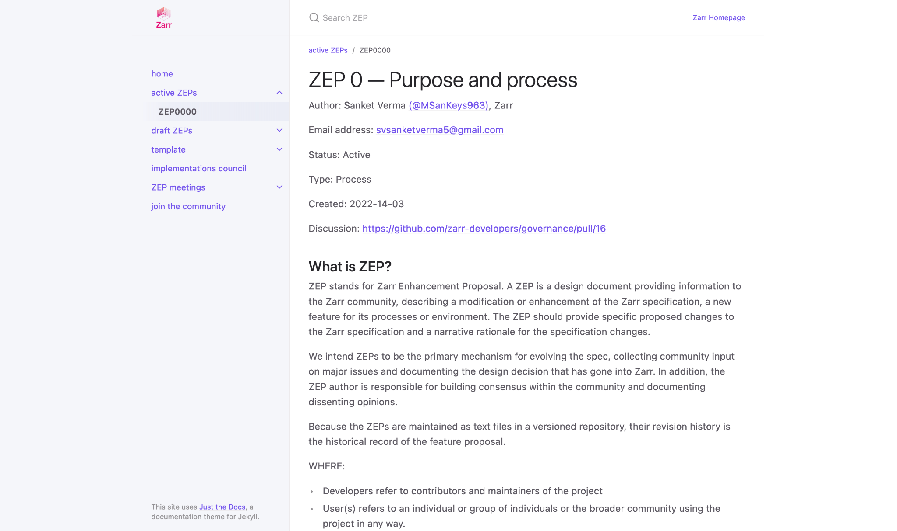
zarr.dev/zeps

Slide 45
How we did it? 🚶🏻‍♂️

Slide 46

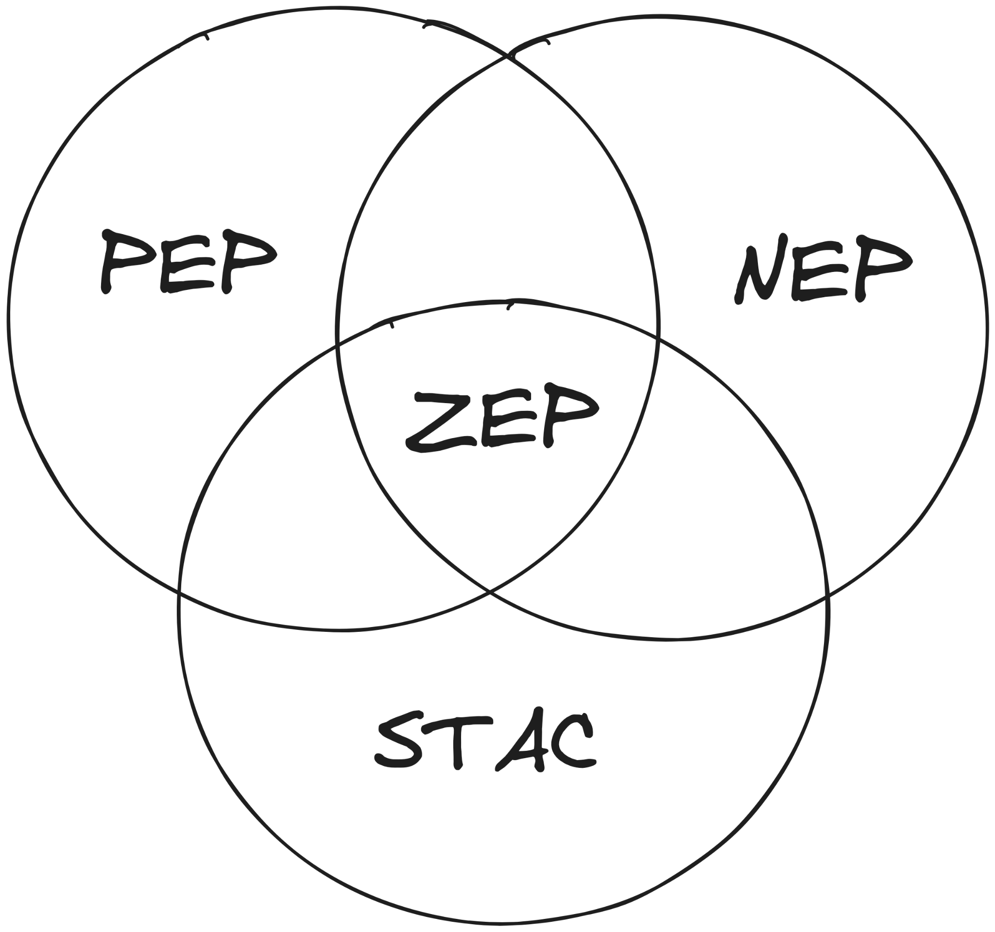

Lots of Reading
Previous Experience
Understanding the needs of the community

Slide 47

Braindump 🧠
ZEP Inception Blog post

Slide 48
How do we adopt a ZEP?

Slide 49


→

Slide 50
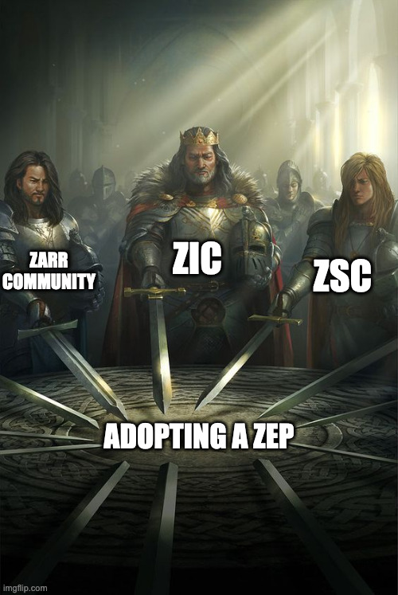

Slide 51
Demo

Slide 52
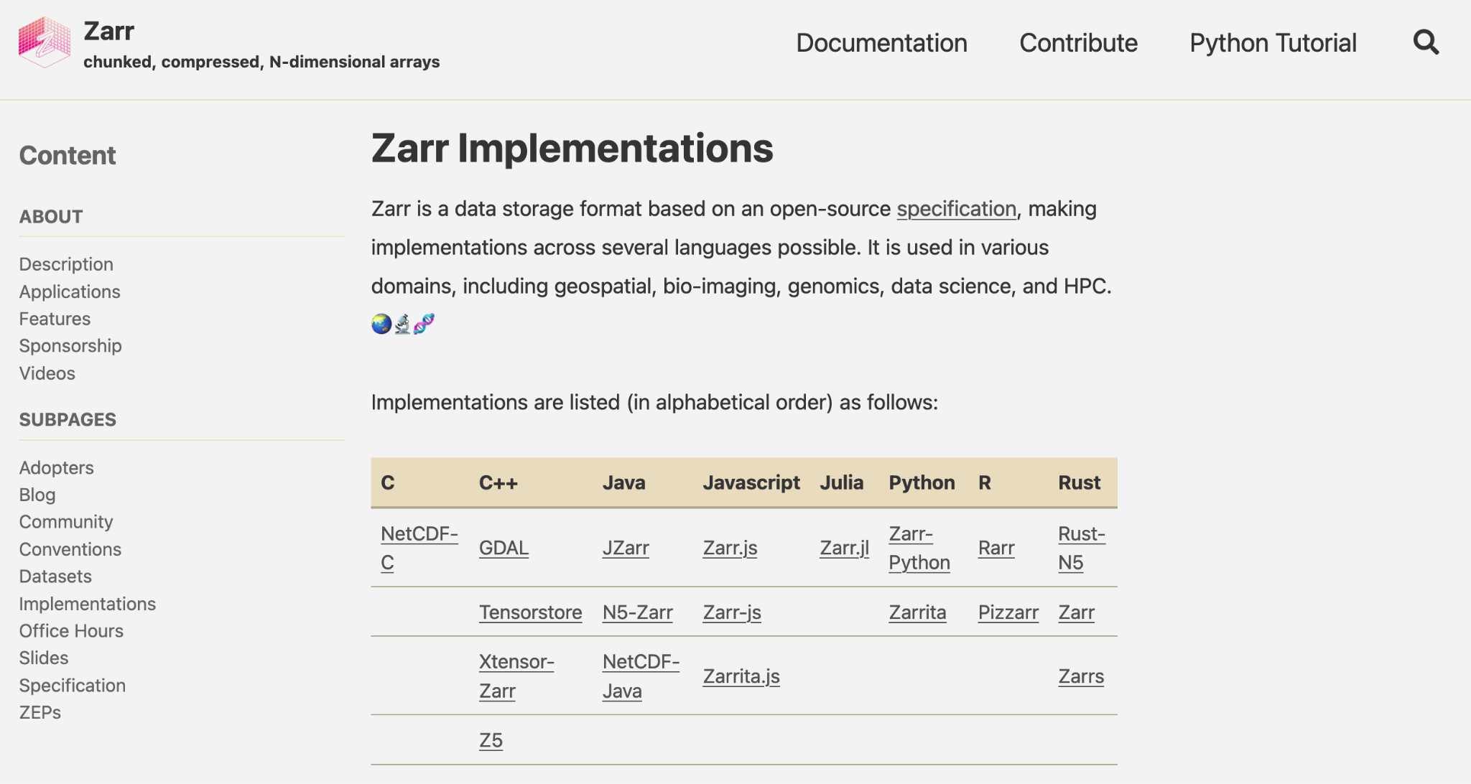
zarr.dev/implementations

Slide 53
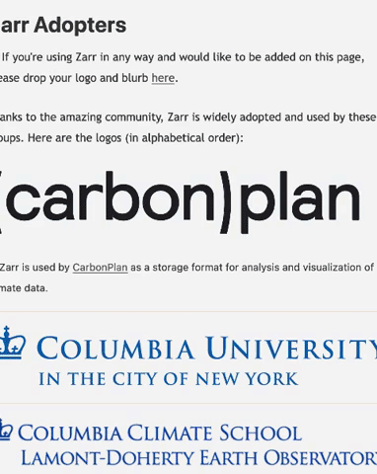
zarr.dev/adopters

Slide 54
How does V3 data looks like?

Slide 55



Citation:
Motta et al., Science 2019
Maintained by: /normanrz
(Norman Rzepka)
https://webknossos.org/links/NxMfC4B65CmTVGhr

Slide 56


/neuroglancer
https://github.com/google/neuroglancer
Maintained by: /jbms
(Jeremy Maitin-Shephard)
Neuroglancer visualiser

Slide 57
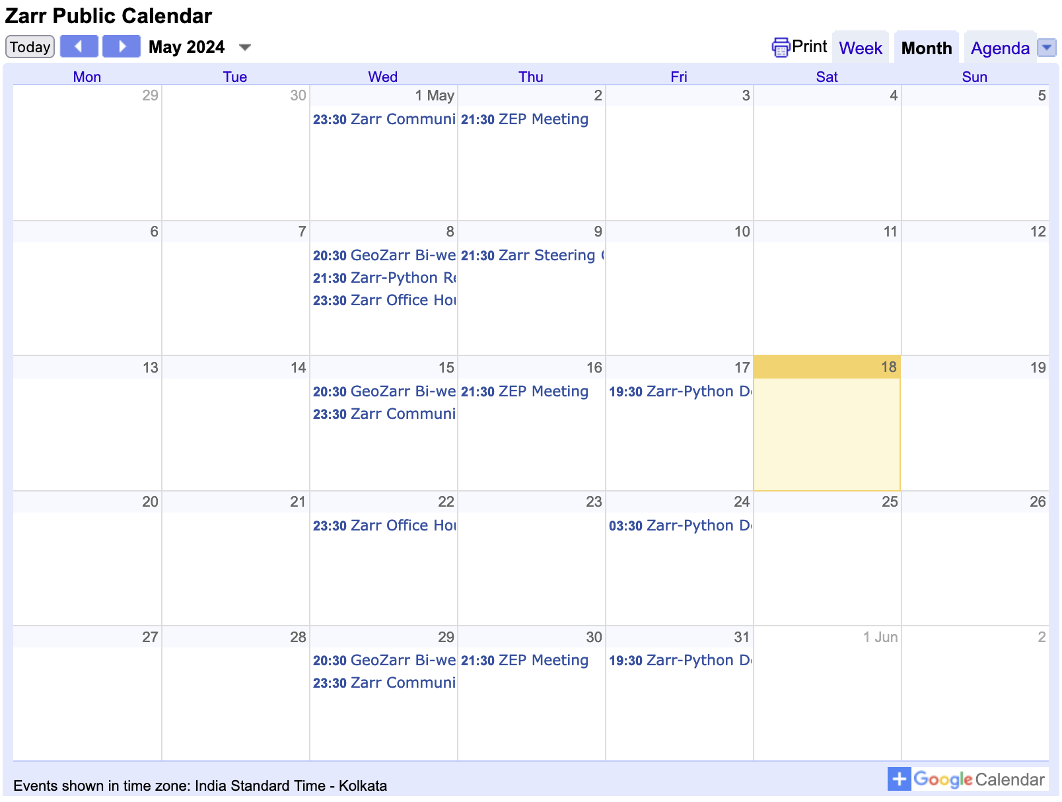
Join us at community, ZEP, core-dev meetings or office hours!
https://zarr.dev/community-calls/

Slide 58

Thank you! 🙏🏻
/zarr_dev

